Slide 1
Gaming the System: A Proof of Concept
Anna Huynh

Slide 2
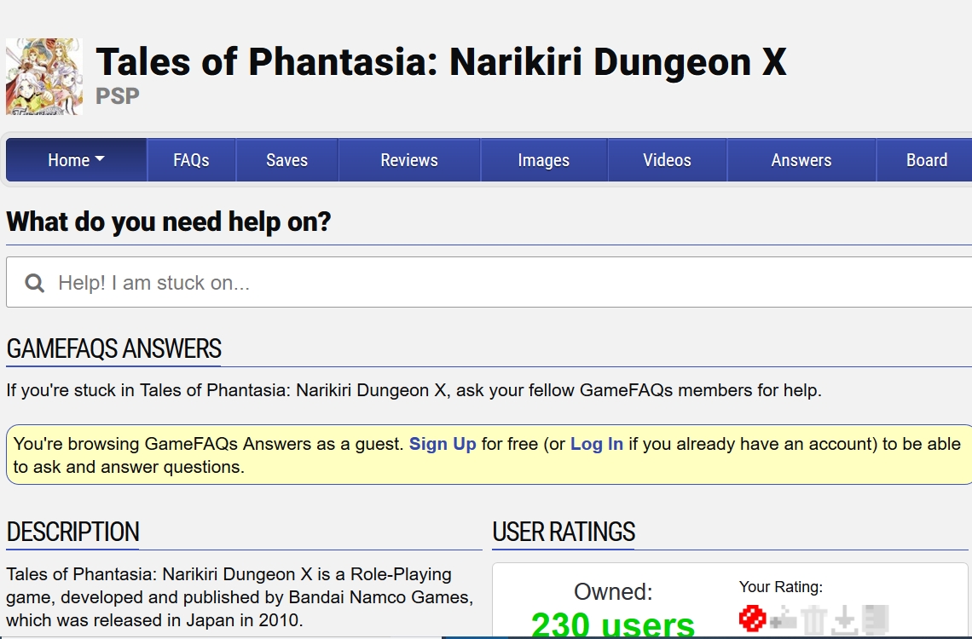
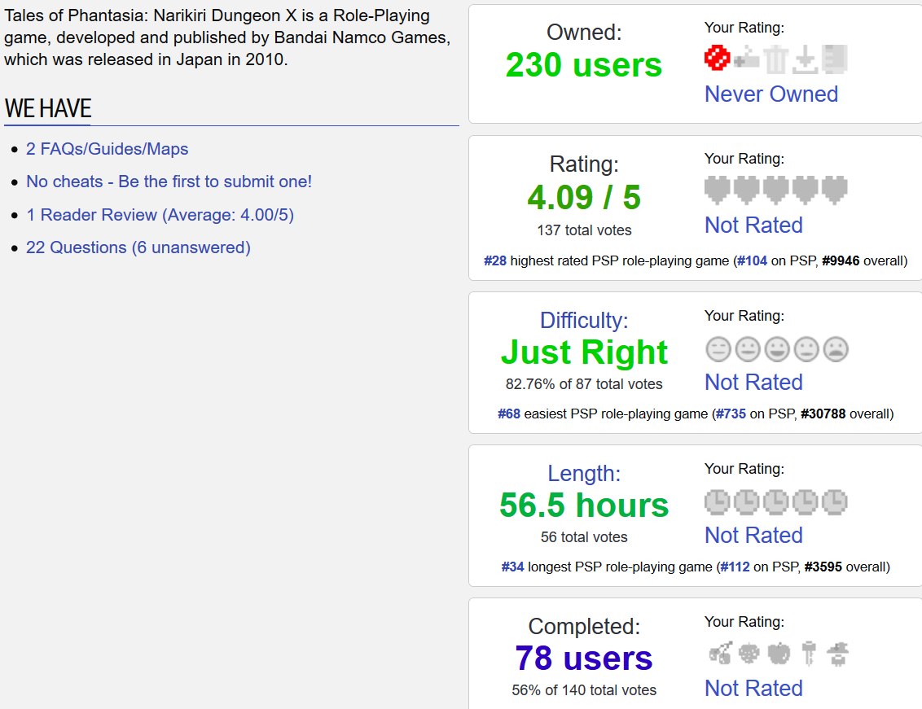
Stealing from GameFAQs
No known API, so I made my own code to scrape.
Extracted number of owners, rating, number of votes for rating, difficulty, number of votes for difficulty, game length, number of votes for game length, number of users who completed the game, and completion rate
Only interested in RPG’s for now

Slide 3
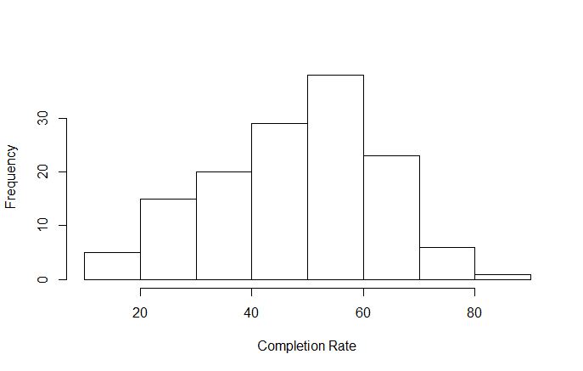
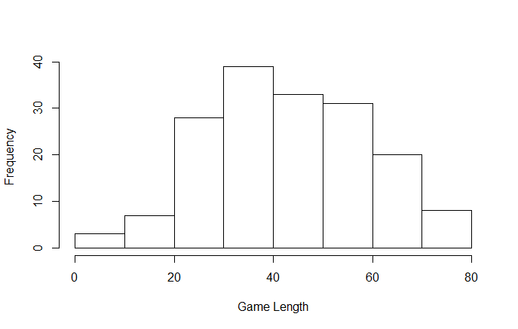
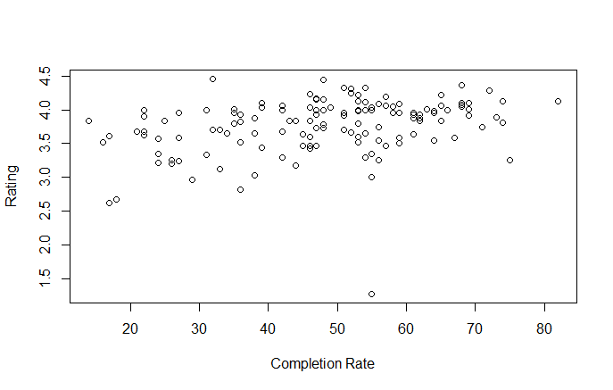
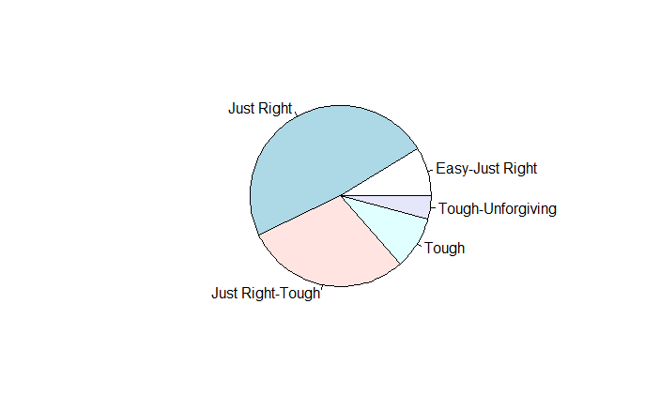
Looking at just the PSP RPG’s

Slide 4
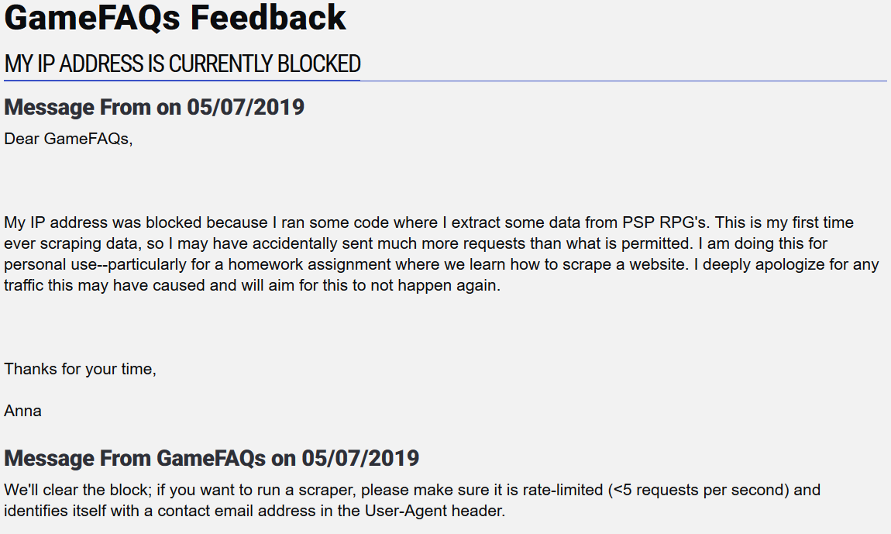

Goals and Plans
Fix my scraping code since some of the game urls were incompatible with it
Avoid getting IP banned(oops!)
Look at other systems: SNES, GBA, DS, 3DS, PS1, PS2, PS3, PS4
See which RPG’s are worthwhile for me to play through unsupervised learning--probably mainly using K-means clustering
Probably consider looking at strategy games as well

